Slide 1
Canadian Association of Nuclear Medicine
February 7-9, 2019
Cynthia A Doerr, MD

Slide 2
Misadministration of Sn-117m Colloid During Radiosynoviorthesis Presents No Safety Concerns

Slide 3
Disclosure
Cynthia Doerr MD is an employee of Serene, LLC

Slide 4
Background and Objectives
Background: Radiosynoviorthesis is the intraarticular injection of a radionuclide for the therapy of osteoarthritis and rheumatoid arthritis in humans.
Objective: Demonstrate the safety of homogeneous Sn-117m colloid (HTC) when intentionally or unintentionally misadministered.
Three events:
Cutaneous, subcutaneous and oral exposure in rats
Intravenous administration in rats
Inadvertent misadministration in a client-owned dog

Slide 5
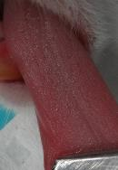
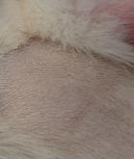
1) Cutaneous, Subcutaneous and Oral Exposure--Rat
12 Sprague Dawley rats administered 25uCi/0.925MBq HTC (equivalent to 7.5mCi/227MBq in a human)
4 administered subcutaneous injection (followed 4 weeks)
4 administered orally (followed 2 weeks)
4 administered topical (followed 2 weeks)
Visual observation in all groups
Results:
No signs of abnormality

Slide 6
2) Intravenous Exposure--Rat
20 Sprague Dawley rats administered 25uCi/0.925MBq HTC (equivalent to 7.5mCi/227MBq in a human)
5 sacrificed at 1 hour
5 sacrificed at 4 hours
5 sacrificed at 24 hours
5 sacrificed at 14 days (1 half-life)
Biodistribution in all groups
Results:
No toxicity noted

Slide 7
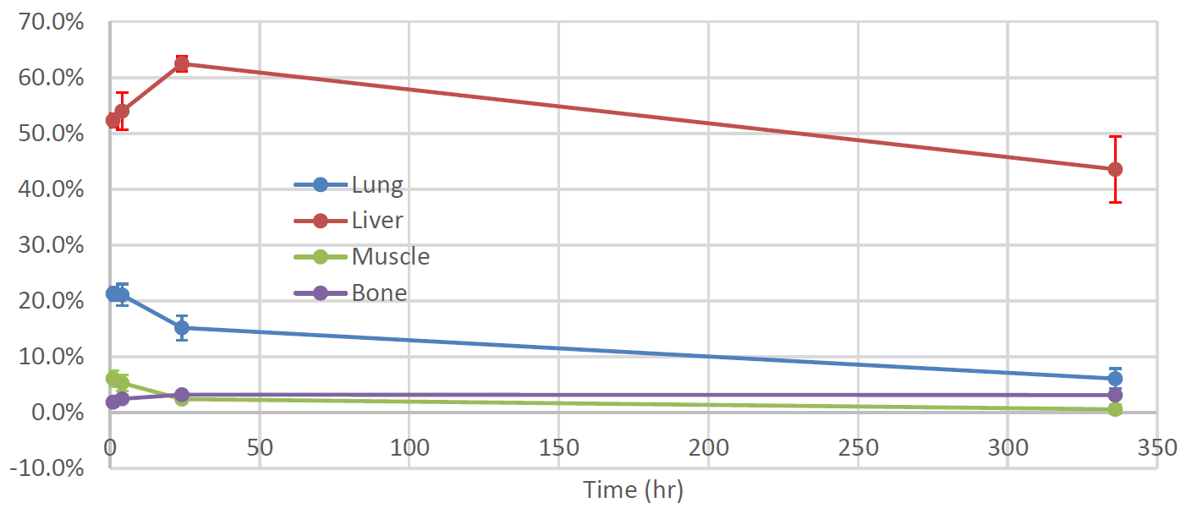
Intravenous Exposure--Biodistribution
Percent injected dose at major sites of accumulation
Bone uptake slightly increasing due to natural Sn affinity

Slide 8
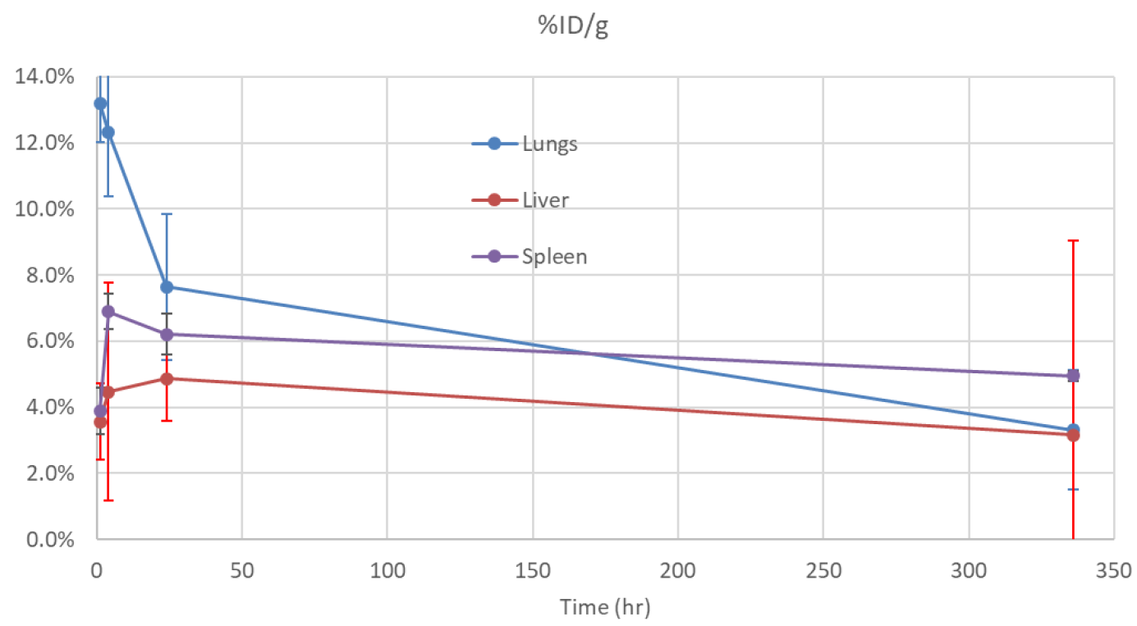
Intravenous Exposure—Biodistribution cont.
Percent injected dose/gram for lungs, liver, spleen

Slide 9
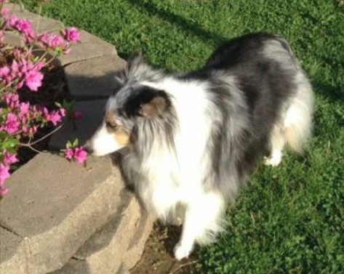
3) Inadvertent Misadministration—Client-owned Dog
Client-owned pet dog participated in a clinical trial of elbow OA and received
1.61m Ci/59.6 MBq HTC. The needle bevel moved during administration and the entire dose was administered into the periarticular tissues, discovered 3 days after administration at the time of scintigraphy.
Results:
No toxicity noted by clinical staff or owner
No medical intervention was warranted
Returned for an additional Sn-117m treatment
4/25/16

Slide 10
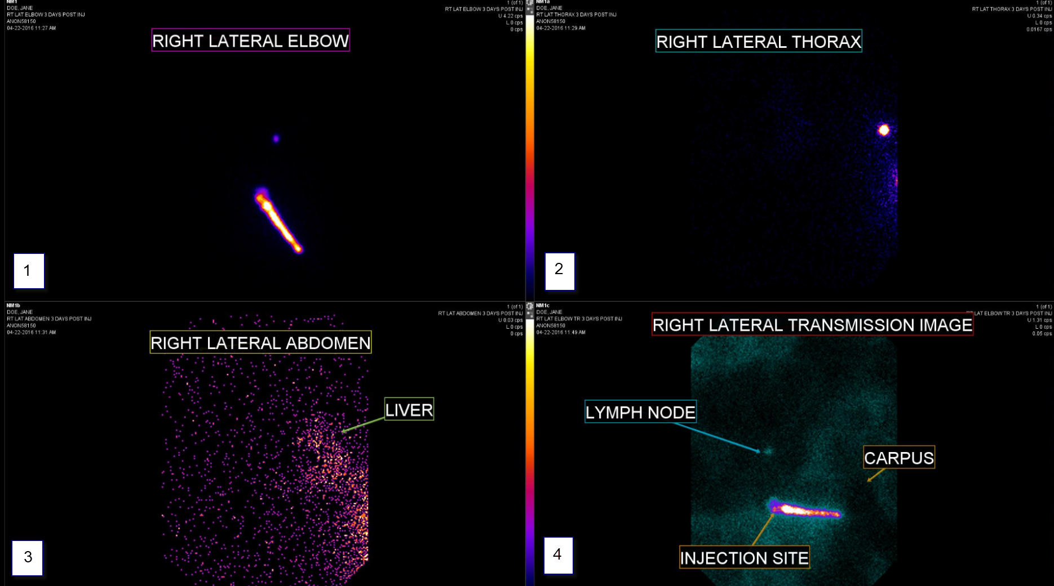
Inadvertent Misadministration—Client-owned Dog cont.

Slide 11
Conclusion
Sn-117m homogeneous colloid therapy is safe even when misadministered outside the intended treatment area.

