Slide 1
Convetra, Inc.

Slide 2
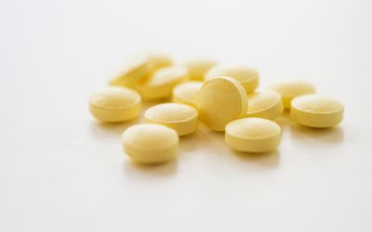
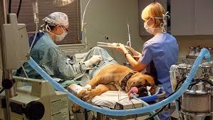
Canine OA Pain Management Market: 2 Major Gaps
Daily Drugs
Ineffective for many
Long-term safety issues
Poor compliance
Therapeutic Gap
No durable, proven intermediate treatment options
Joint Replacement
Not for all joints
High risk for older pets
Disruptive rehab
$4.2B Veterinary Revenue Gap
~2M cases / year referred
only ~0.6M treated¹
General Practices
Specialty Hospitals
¹Harmony Marketing Partners survey results, 2016

Slide 3
OA and Synovial Macrophages
The role of synovial macrophages and macrophage-produced cytokines in driving aggrecanases, matrix metalloproteinases, and other destructive and inflammatory responses in osteoarthritis Bondeson J, Wainwright SD, Lauder S, et. al. Arthritis Research & Therapy 7 2006 8:R187(doi:10.1.186/ar2099)
Synovial inflammation is implicated in many signs and symptoms of OA, including joint swelling and effusion
In the osteoarthritis synovium, both inflammatory and destructive responses are dependent largely on macrophages and these effects are cytokine driven through a combination of IL-1 and TNFα
These cytokines can stimulate their own production and induce synovial cells and chondrocytes to produce IL-6, IL-8, leukocyte inhibitory factor; as well as stimulate protease (matrix metalloproteinases (MMPs) and aggrecanases) and prostaglandin production
“Results suggest prioritization of attempts to modify macrophage function in OA, with the aim of decreasing both inflammatory synovitis and the production of degradative enzymes (cytokines) of importance for the progression of the disease”
Notes:
Synovitis is implicated in signs and symptoms.
Macrophages drive destructive responses: IL-1 and TNFα
Cytokines can be self-producing
Key Point: Reducing synovial macrophages will lead to modifying OA disease.
Accordingly: macrophage targeting would be ‘Disease Modifying” intervention

Slide 4
Radio·synovi·ortheses
What is radiosynoviorthesis (RSO)? Intra-articular injection of radioisotope (radionuclide) to treat joint inflammation
Mode of action: Radionuclide is absorbed by synoviocytes and phagocytized by macrophages within the synovium resulting in apoptosis and non-inflammatory ablation of inflammatory cells
The homogeneous tin colloid suspension (1.5 – 20 µm) of tin-117m emits discrete (0.3 mm radiation range), low-energy conversion electron radiation
The colloid containing micro particles is retained in the canine joint space for at least 42 days (3 half-lives)
Mechanism of cell death from Synovetin OA is from extended duration (T_{1/2} = 14d) low energy radiation (<158 keV) exposure effects
Notes:
RSO is a treatment procedure

Slide 5
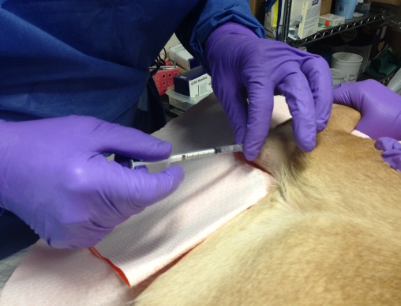
How Safe is in Canines?
Cumulatively 100 elbows of 75 dogs injected
Examined multiple times post-treatment over 12 months
PE, CBC, Chem screen, UA, Joint fluid, lameness, range of motion, limb circumference, force plate, MRI, PET, CT, radiographs, Brief Pain Inventory, Colorado chronic pain scoring, concomitant meds, radiation, scintigraphy modalities were used
3 sites LSU, MU veterinary schools and Gulf Coast Veterinary Specialists in Houston
No safety associated parameters fell outside of expected norms (including a mis-administration)
Notes:
3 sites: LSU, Missouri, Gulf Coast
No safety anomalies

Slide 6
Clinical Studies Trialing
Canine
Study name | Study Number | Date Injected | Number Evaluated | Site
5 normal dog safety study | None assigned by University of Missouri | March 31, 2015 to May 15, 2015 | 5 (5 elbows) | University of Missouri College of Veterinary Medicine, J. Lattimer DVM, DACVR
Grade 1 & 2 elbow OA client dog study | None assigned by University of Missouri | October 14, 2015 to last dog evaluated Feb. 27, 2017 | 44 (46 elbows) | Gulf Coast Veterinary Specialists, M. Fabiani, DVM, DACVR; C. Hudson DVM, DACVS, B. Beale DVM, DACVS Louisiana State University School of Veterinary Medicine, K. Aulakh, DVM, DACVS University of Missouri College of Veterinary Medicine, J. Lattimer DVM, DACVR
Grade 3 elbow OA client dog study | C-22017 | June 21, 2017 to July 26, 2017 | 15 (27 elbows) | GCVS, Houston, TX LSU-SVM, Baton Rouge, LA
Re-injection of 117m Sn colloid (Synovetin OA) in grade 1 or 2 client dog study | C - 80817 | September 11, 2017 to October 13, 2017 | 10 (20 elbows) | LSU-SVM, Baton Rouge, LA MU-CVM, Columbia, MO
Studies C-22017 and C-80817 are GMP, GCP and GDP pivotal studies validating commercially produced Synovetin OA™ and the commercial manufacturing process utilizing Theragenics, Inc. a human medical radioisotope manufacturer based in Buford, GA (NE of Atlanta)
Notes:
Canine elbow was the study joint of focus due to its medical challenge in clinical cases.

Slide 7
How Effective is ?
Canine Brief Pain Inventory
Client survey about reduction in pain and level of activity
Each time point survey compared to baseline survey results
37 dogs initially treated with the label dose of Synovetin OA
3 month results
15/37 (40%) both pain AND level of activity improved successfully (conventional cBPI success)
24/37 (65%) one OR other improved successfully with NO worsening of the other (client success)
6 month results
14/35 (40%) both pain AND level of activity improved successfully
24/35 (69%) pain OR level activity improved successfully with NO worsening of the other
Notes:
Note: Conventional cBPI success occurs when BOTH reduction of pain survey averages and level activity survey averages are improved by a certain amount when compared to the baseline presenting lameness measures. In reality when a veterinarian treats a lame dog and a client sees their dog improve in either a reduction in pain OR an increase of activity with no worsening of the other measurement this is a success, too. This is why the data is presented in these 2 ways. The measure of success is the same for pain and level of activity the difference is whether one or both are occurring for an overall success.

Slide 8
How Effective is ?
Canine Brief Pain Inventory
Client survey about reduction in pain and level of activity
Each time point survey compared to baseline survey results
37 dogs initially treated with the label dose of Synovetin OA
9 months results
20/32 (62%) both pain AND level of activity improved successfully
25/32 (78%) one OR other improved successfully with NO worsening of the other
12 months results
16/31 (52%) both pain AND level of activity improved successfully
24/31 (77%) one OR other improved successfully with NO worsening of the other
Notes:
Note how the results improve at 9 and 12 months supporting the described mode of action in which the synovial lining inflammation (synovitis) and pain is reduced over an extended period of time. With the reduction of synovitis; the synovial lining functions more normally in the continuing presence of degenerative joint disease (arthritis). This is the reason for the long lasting effect from a single injection into an arthritic joint. Realizing that with the continuing degenerative joint disease (arthritis) clinical synovitis will reoccur necessitating another treatment at a later date.

Slide 9
How Effective is ?
Force plate analysis of Grade 1 or 2 elbow OA (single leg injection)
22 dogs with grade 1 or 2 elbow OA in which the most painful elbow was injected
> 5% positive change in PVF or VI considered a successful treatment effect
Each dog served as its own control comparing each time point to initial baseline data
3 different dosages (1.0, 1.75 and 2.5 mCi per joint for 50 lb. dog)
18/22 (82%) treatment effect at one or more time points
1 month – 9/22 (41%) treatment success
3 months – 13/22 (59%) treatment success
6 months – 13/21 (62%) treatment success
9 months – 11/18 (61%) treatment success
12 months – 4/13 (31%) treatment success

Slide 10
How Effective is ?
Force plate analysis of Grade 1 or 2 elbow OA (elbow reinjection )
10 dogs with grade 1 or 2 elbow OA in which both affected elbows were injected
> 5% positive change in PVF or VI considered a successful treatment effect
Each dog served as its own control comparing each time point to initial baseline data
Label dosed (1.75 mCi per joint in a 50 lb. dog)
Baseline, 3 and 6 month force plate evaluations only
6/9 (67%) treatment effect at one or more time points
3 months – 5/9 (56%) treatment success
6 months – 6/9 (67%) treatment success

Slide 11
How Effective is ?
Clinicians lameness assessment (single leg injected)
Lameness grading from 0 – 5 (worst)
Evaluated at walk and trot before and after joint manipulation
Each dog served as its own control comparing each time point to initial baseline data
34 dogs in the Per Protocol group
3 different dosages (1.0, 1.75 and 2.5 mCi per joint for 50 lb. dog)
9 months – changes from baseline, indicating improvement from baseline, were found to be statistically significant (n=18)
12 months – changes from baseline, indicating improvement from baseline, were found to be statistically significant (n=19)
McNemars test –the comparison of cBPI success to clinician-assessed lameness success comparing baseline to each visit indicated statistical agreement.

Slide 12
Mykonos Experience With
Mykonos, 1.5 year old, castrated male, 88 lb. German Shephard, bilateral ununited anconeal prs.
Right elbow injected with label dose 10/14/15
Left elbow injected with label dose 9/20/16
Both elbows injected with label dose 12/18/17
cBPI scoring | Baseline | 1 mos. | 3 mos. | 6 mos. | 9 mos. | Baseline² | 1 mos. | 3 mos.
Date | 10/13/15 | 11/10/15 | 1/7/16 | 4/1/16 | 7/7/16 | 9/19/16 | 10/26/16 | 12/15/16
Pain Severity Score (Q 1-4) | 6.25 | 2.00 | 0.75 | 0.00 | 0.00 | 6.00 | 0.00 | 0.00
Pain Interference Score (Q 5-10) | 2.17 | 0.83 | 0.00 | 0.33 | 0.00 | 7.17 | 0.00 | 0.00
Quality of Life Score (Q 11) | Good | Very Good | Very Good | Excellent | Excellent | Poor | Excellent | Excellent
Baseline prior to left elbow injected
Baseline² prior to right elbow injected
Notes:
Baseline prior to left elbow injected
Baseline2 prior to right elbow injected
Baseline3 prior to both elbows injected

Slide 13
Mykonos Experience With
Mykonos, 1.5 year old, castrated male, 88 lb. German Shephard, bilateral ununited anconeal prs.
Right elbow injected with label dose 10/14/15
Left elbow injected with label dose 9/20/16
Both elbows injected with label dose 12/18/17
 | 6 mos. | 9 mos. | 12 mos. | Baseline³ | 3 mos. | 6 mos. | 9 mos. | 12 mos.
Date | 3/23/17 | 6/22/17 | 9/21/17 | 12/17/17 | 5/4/18 | 7/6/18 | 9/21/18 | 12/30/18
Pain Severity Score (Q 1-4) | 0.00 | 0.00 | 0.00 | 0.75 | 0.00 | 0.00 | 0.00 | 0.00
Pain Interference Score (Q 5-10) | 0.00 | 0.00 | 0.00 | 0.67 | 0.00 | 0.00 | 0.00 | 0.00
Quality of Life Score (Q 11) | Excellent | Excellent | Excellent | Very Good | Excellent | Excellent | Excellent | Excellent
Baseline³ prior to both elbows injected
Notes:
Baseline prior to right elbow injected
Baseline2 prior to left elbow injected
Baseline3 prior to both elbows injected

Slide 14
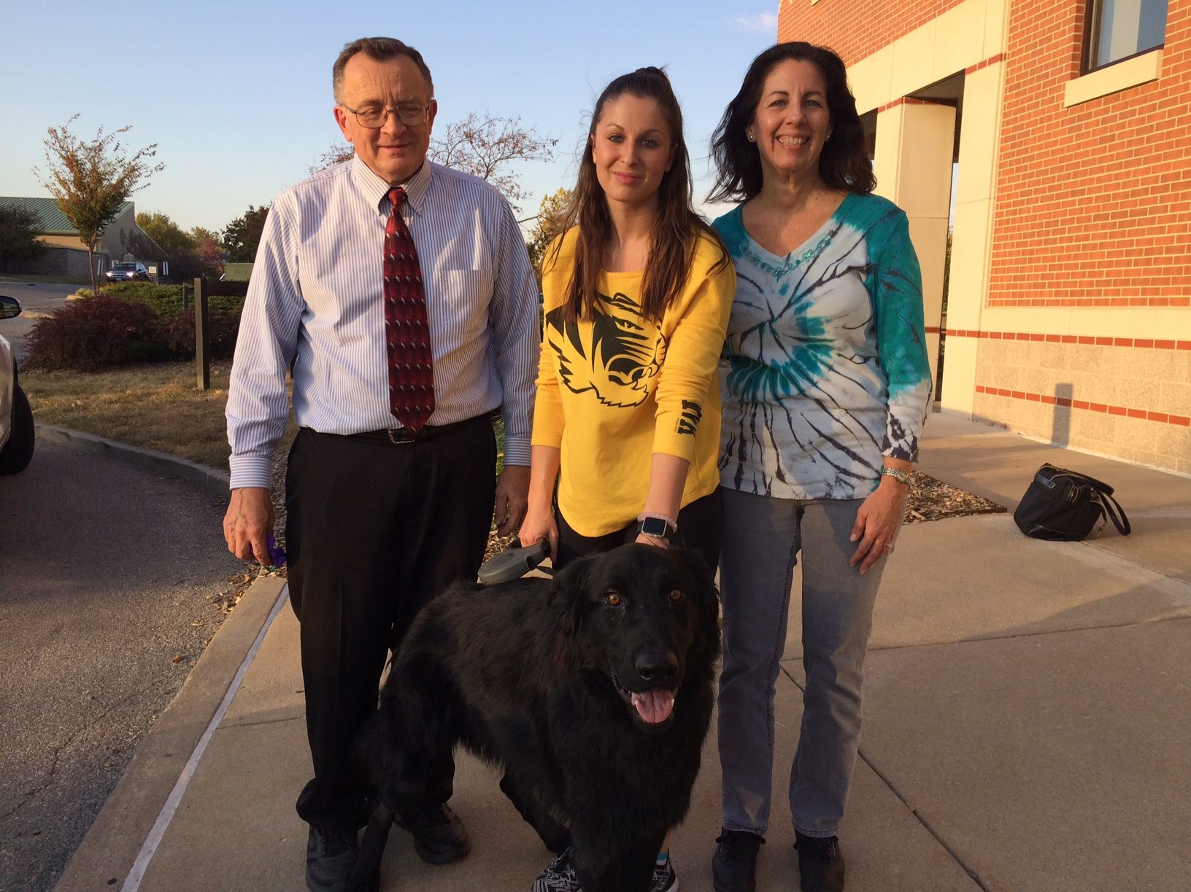
Mykonos Experience With

Slide 15
Summary
Tin-117m is a radiotherapeutic device with a unique mode of action that targets inflammatory cells which incite multiple inflammatory cytokinetic cascades. This device not only reduces pain, but also alters the progression of arthritis; hence, ‘disease modifying’. (‘disease modifying’ is intuitive based on mode of action; however, must be clinically validated in dogs)
Due to its unique mode of action, tin-117m is not associated with the historical adverse drug events seen with NSAIDs: gastrointestinal, renal, platelet and hepatic
Tin-117m provides veterinary specialty clinics another revenue stream through addressing arthritic dogs refractive to general ‘standard of care’ treatments

Slide 16
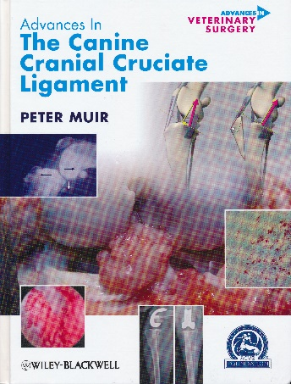
Evidence of Pre-Radiographic Synovitis
Studies in dogs with cranial cruciate ligament (CrCL) deficiency and rupture...
>$1.32B/year is spent on ACL disease in the US (JAVMA 2005,227:1604-1607)
Synovitis is an early feature of arthropathy in dogs with minimally detectable damage
Sources: Klocke NW, et al. Am J Vet Res. 2005;66:493-499; Doom M, et al. Vet Immunol Immunopathol. 2008;125:143-161; Bleedorn JA, et al. Vet Surg. 2011;40:531-543.
Notes:
Studies show consistent presence of synovitis and increased density of synovial macrophages,
Showing histological changes consistent with low-grade inflammation

Slide 17
Next Steps
Clinical Experience program:
Convetra is recruiting 10 specialty hospitals to introduce Synovetin OA
Profile of specialty hospital candidate
Surgeon(s) with an interest in sports medicine and rehabilitation
Gait analytics
Perform arthroscopy
Hospital has an existing RAM license (I-131 or Technetium)
Radiologist interested in nuc med
Searchable patient data base
Convetra will:
Provide Synovetin OA to treat 3 dogs with elbow OA
Support amending RAM license to add tin 117m
Train RSO and Authorized Users
Figure: Canine elbow IA injection of tin-117m

Slide 18
Thank you

