Slide 1
Simultaneous Localization and Treatment of Vulnerable Plaque by Tin-117m Conversion Electrons: First-in-Human Results
Vulnerable Plaque Opportunities
Renu Virmani, MD
CVPath Institute, Inc.
Gaithersburg, Maryland, USA

Slide 2
Disclosure Statement of Financial Interest
Within the past 12 months, I or my spouse/partner have had a financial interest/arrangement or affiliation with the organization(s) listed below.
Affiliation/Financial Relationship
Company
Consulting Fees
Abbott Vascular
480 Medical / Arsenal Medical
Atrium Medical Corporation
Biosensors International
GlaxoSmithKline
CBard/Lutonix
Medtronic AVE
Terumo Corporation
W.L.Gore

Slide 3
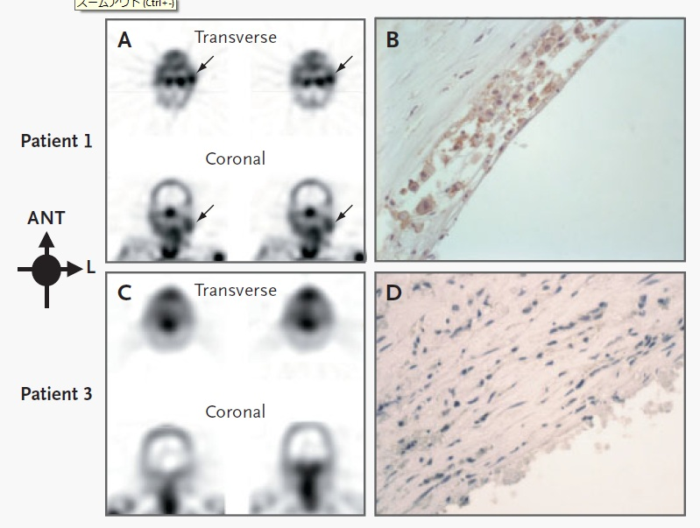
Noninvasive Detection of Plaque Instability with Use of Radiolabeled Annexin A5 in Patients with Carotid Artery Atherosclerosis
Patient 1:
TIA 3 days before imaging
Uptake of radiolabeled annexin A5 only in the culprit lesion (arrows)
Macrophages within the neointima, with extensive binding of annexin A5 (brown)
Patient 3:
TIA 3 months before imaging
No evidence of annexin A5 uptake
SMC rich lesion, negligible binding of annexin A5
SPECT
Histology (Endarterectomy)
Narula J, et al. N Engl J Med 2004; 350: 1472-3.

Slide 4
Tin-117m Has Unique Capabilities
Beta
#
Conversion electrons (C.E.) 140 KeV discrete energy for therapy have a 290 μm range
Lower external radiation
Easier handling and reduced hospitalization containment
C.E. have been proven to induce apoptosis
Half-life of 14 days is consistent with treatment requirements
Logistic flexibility
Cell division cycles and therapy dosing
Gamma ray (159 KeV) similar to Tc-99m (140 KeV) allowing for existing standard gamma camera imaging & techniques
Avg.
Energy
Produces a range of tissue penetration, some deep
Conversion Electron
#
Energy
Penetrates a set distance (discrete energy)
 | Tin-117m | Alpha Particles¹ | Beta Particles²
Range in tissue (µm) | 290 | 40-90 | 50-5000+
Shielding needed during administration | No | No | Yes
¹ALPHARADIN; ²Metastron & Quadramet

Slide 5
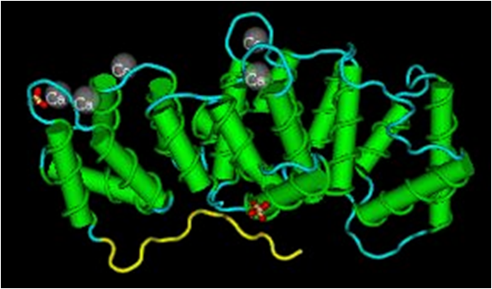
The Product is Comprised of a Radioisotope, Tin-117m, That is Held within a DOTA Molecule Linked to a Targeting Molecule, Annexin V
DOTA
Annexin V-128
Amino benzyl Linker
Tin-117m
Tin-117m
Therapeutic conversion electron has strong ionization effect over relevant biological range (<300 µm)
14 day half-life is ideal for therapy
High specific activity suitable for labeling proteins and antibodies
Imaging compatible with existing SPECT gamma cameras
Annexin V
Naturally occurring human protein
Annexin V binds to specific cell membrane chemicals that are expressed in apoptotic macrophages
Amino benzyl DOTA
Securely holds the Tin-117m
Links Tin-117m to annexin

Slide 6
Therapeutic Application of Tin-117m-DOTA-Annexin
Tin-117m-DOTA-Annexin Addresses the Therapeutic Unmet Needs of Vulnerable Plaque
Non-invasive
An IV systemic injection provides localized vulnerable plaque therapy
Targets and treats vulnerable plaque inflammation in the necrotic core
Treats vulnerable plaque without damaging the surrounding tissue
Half-life allows for one month of therapy with a single injection
Therapeutic outcome can be measured with imaging using the same product

Slide 7
PRE-CLINICAL AND CLINICAL STUDIES
ANIMAL PRE-CLINICAL STUDIES COMPLETED AND HUMAN CLINICAL STUDIES - COMPLETED AND ONGOING
ANIMAL Pre-clinical Studies
Normal mouse and rabbit BD and atherosclerotic rabbit BD, therapy and imaging studies
CAROTID #1 (Very Low Dose Study)
Imaging and pathology on 6 CEA patients
500 µCi cGMP dose to determine dosimetry for Carotid #2 study
Pig and rabbit stent therapy studies
Normal mouse sterile abscess pK studies
Preliminary and validating Apo-E mouse therapy studies
CAROTID #2 (Low Dose Study)
Imaging and pathology on 5 CEA patients
Rat toxicity studies
Identification by U/S and histology of VP
Binding to VP
3 mCi cGMP dose
Identification by U/S and histology of VP
Binding to VP
Binding and imaging of AAA
Resuming imaging studies with the addition of therapeutic markers on 5 CEA patients
AAA = abdominal aortic aneurysm, BD = biodistribution, CEA = carotid enarterectomy; VP = vulnerable plaque, U/S = ultra sound

Slide 8
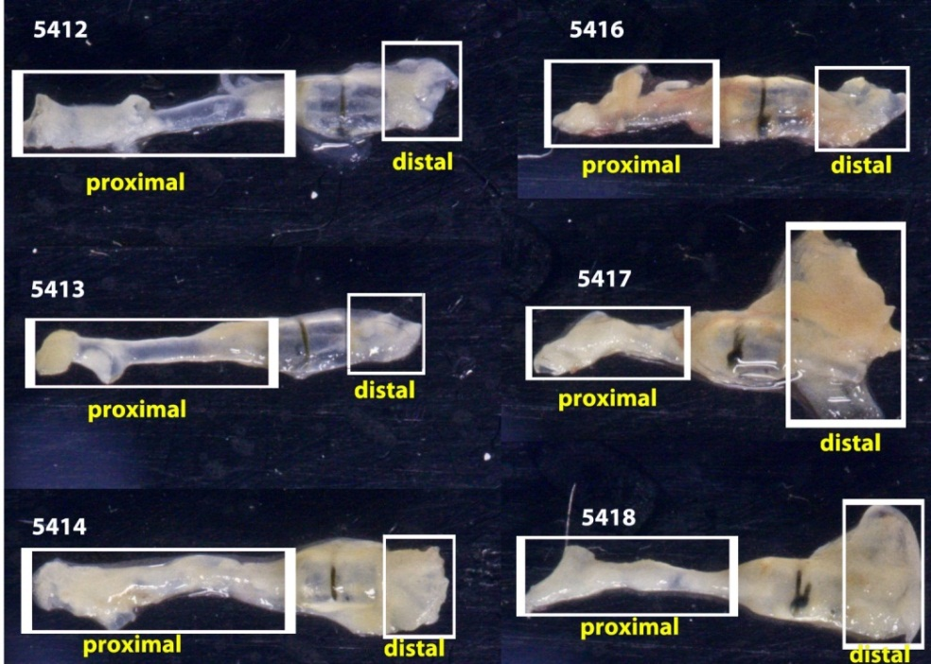
PRELIMINARY APO-E MOUSE THERAPY STUDY
HISTOLOGY STATISTICALLY SIGNIFICANT THERAPEUTIC EFFECT AND CONFIRMS THIS IS A GOOD REPRODUCIBLE ATHEROSCLEROTIC ANIMAL MODEL
Dose ranging study to determine if tin-117m/annexin has a therapeutic effect
26 Apo-E mice with carotid cast, fed on high fat diet for 10 weeks and injected with saline (control), low (1.7 µCi), medium (16.7 µCi) or high (80~83 µCi) doses then continued feeding high fat diet for 4 weeks

Slide 9
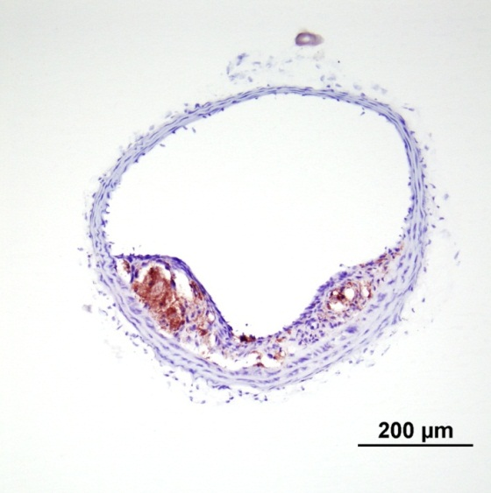
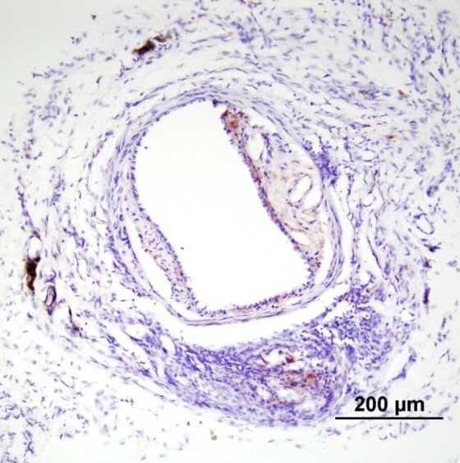
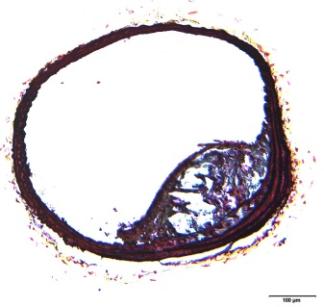
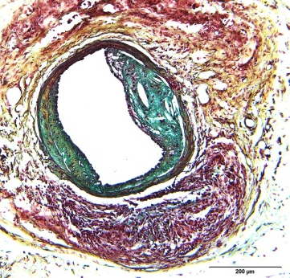
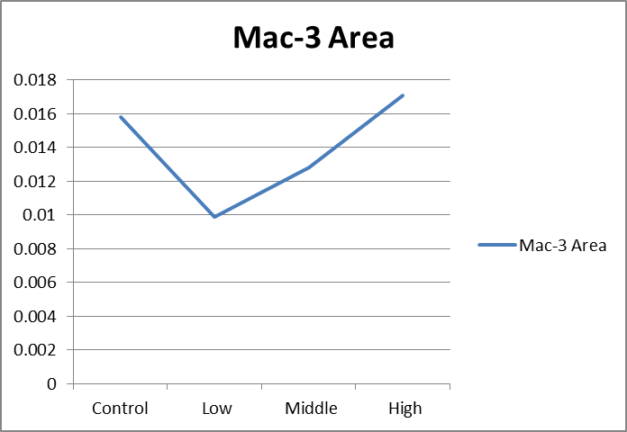
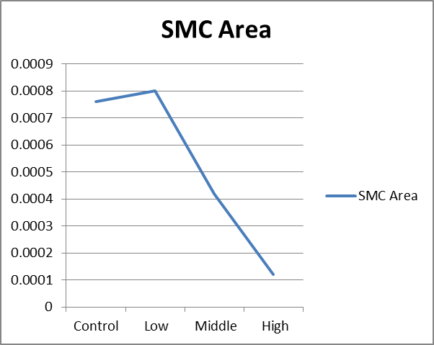
PRELIMINARY APO-E MOUSE THERAPY STUDY
CONTROL MAC-3 VS. LOW DOSE (1.7 µCi) MAC-3
Control
Mac-3
Low Dose
Mac-3
Histology showed reduced macrophage and increased SMC expressions at low (1.7 µCi) group.
In addition, rat toxicity studies showed no indication of toxicity based on blood samples and histologic assessment of the liver and kidney.
1.7 µCi
16.7 µCi
80-83 µCi
1.7 µCi
16.7 µCi
80-83 µCi

Slide 10
Overall Study Scheme:
Tin-117m-Annexin V: the 2nd ApoE Mouse Study
ApoE -/- (n=41 mice)
Dose (µCi)
saline injection
1.0 1.7 3.4
Group I
(n=12)
Group II
(n=9)
Group III
(n=11)
Group IV
(n=9)
12 weeks
6±1 weeks
8±1 weeks
normal chow diet
western diet
injection
Termination
(histology)

Slide 11
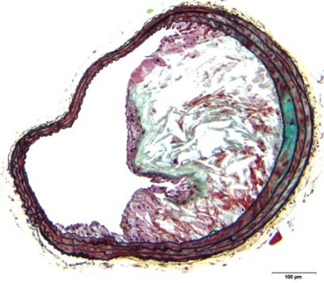
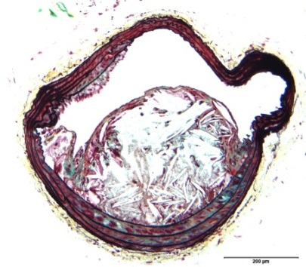
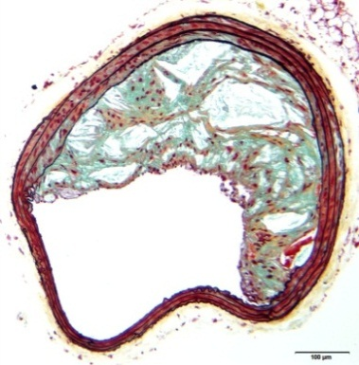
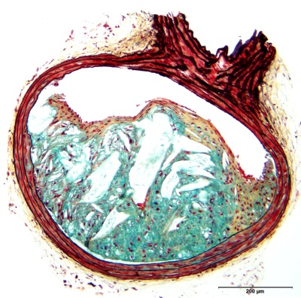
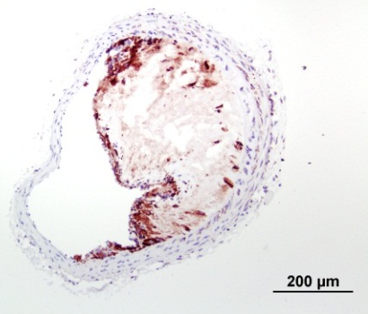
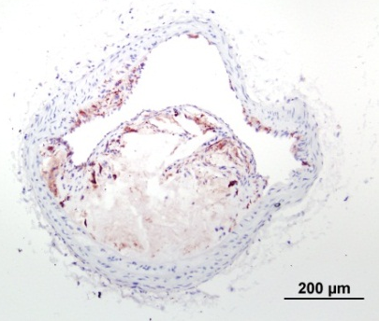
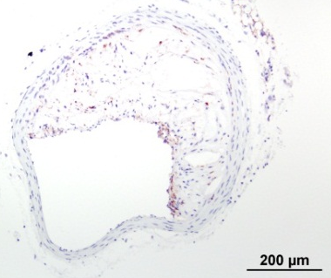
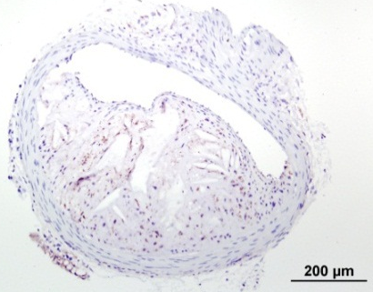
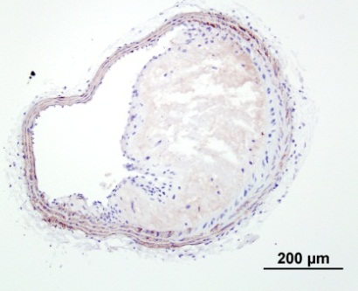
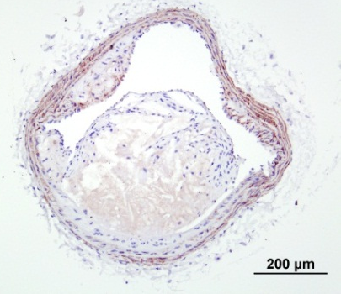
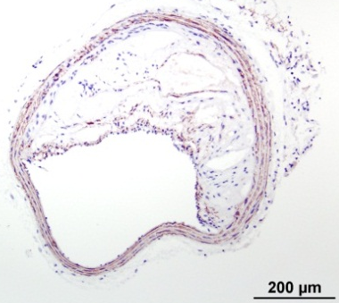
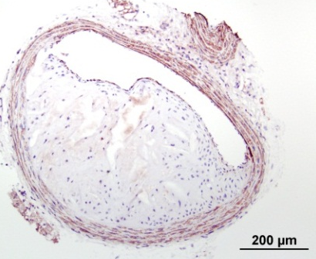
Macrophage and Smooth Muscle Cell Expression
in the Brachiocephalic Arteries: the 2nd ApoE Mouse Study
Low dose (1.0 µCi)
Middle dose
(1.7 µCi)
High dose (3.4 µCi)
Plaque Area (mm²)
Control
0.30
p=0.39 (4 groups)
0.25
Movat
Movat
Movat
Movat
0.20
0.15
0.10
0.05
0.00
Control
Low
Middle
High
(1.0 µCi)
(1.7 µCi)
(3.4 µCi)
Macrophage Area (%)
40
∗p=0.011 vs. control
Mac-3
Mac-3
Mac-3
35
Mac-3
30
25
20
15
10
∗
5
0
Control
Low
Middle
High
(1.0 µCi)
(1.7 µCi)
(3.4 µCi)
α-SMA
α-SMA
α-SMA
α-SMA
SMC Area (%)
8
p=0.81 (4 groups)
7
6
5
4
3
2
1
0
Control
Low
Middle
High
(1.0 µCi)
(1.7 µCi)
(3.4 µCi)

Slide 12
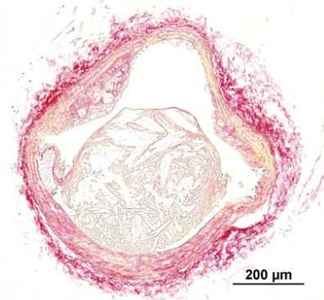
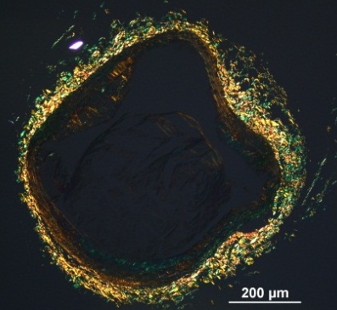
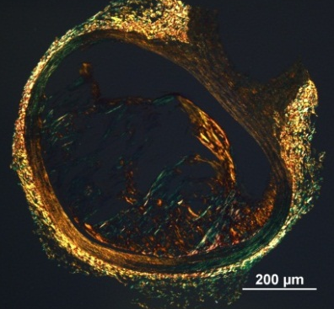
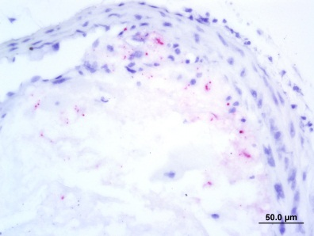
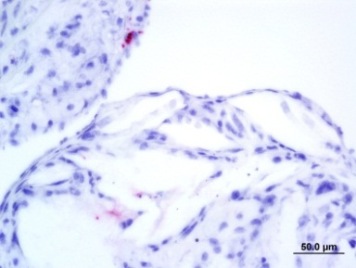
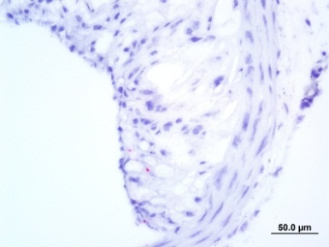
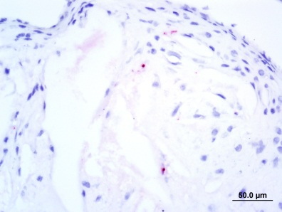
Collagen (Sirius Red Staining) and Apoptosis
in the Brachiocephalic Arteries: the 2nd ApoE Mouse Study
Control
Low dose (1.0 µCi)
Middle dose (1.7 µCi)
High dose (3.4 µCi)
Movat
Collagen (%)
80
∗p=0.06 vs. low dose
∗p=0.17 vs. control
70
∗
60
50
40
30
20
10
Sirius red
0
Control
Low
Middle
High
(1.0 µCi)
(1.7 µCi)
(3.4 µCi)
Apoptosis (%) (Apoptotic body/total cell count in hot spots)
Sirius red
(polarized)
40
35
∗p=0.016 vs. low dose
∗p=0.076 vs. control
∗∗p=0.13 vs. control
30
25
20
15
∗∗
10
∗
5
0
Control
Low
Middle
High
Apoptosis
(1.0 µCi)
(1.7 µCi)
(3.4 µCi)
Sirius red and apoptosis staining were performed in selected mice. (n=24; 6 from each group)

Slide 13
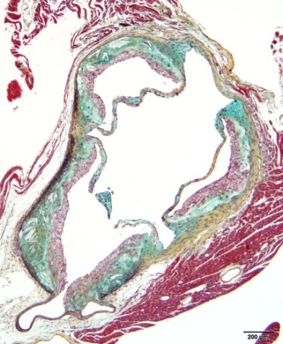
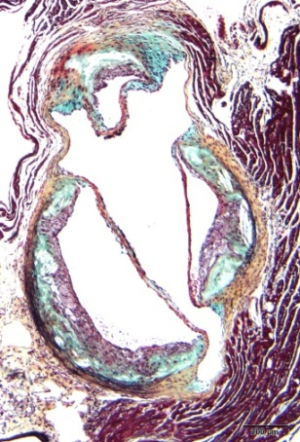
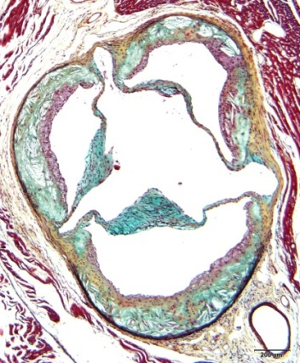
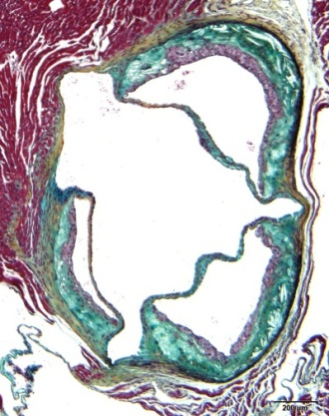
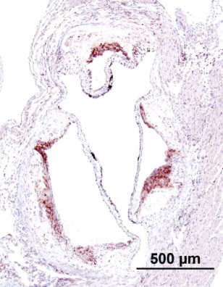
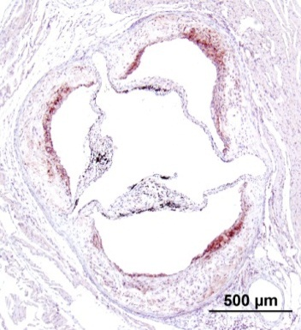
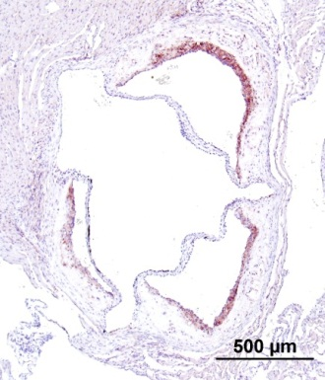
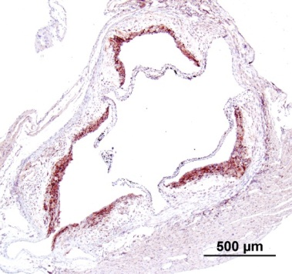
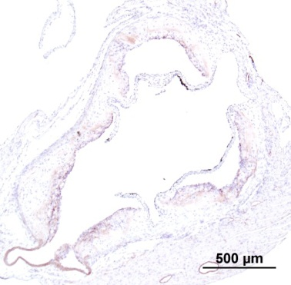
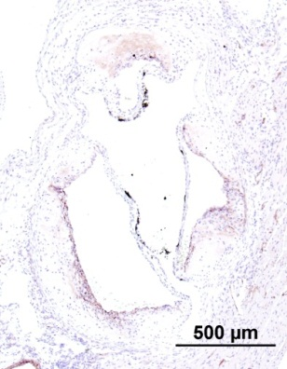
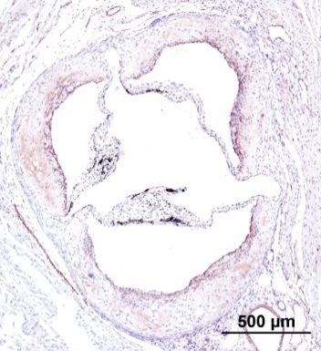
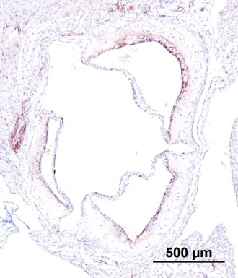
Macrophage and Smooth Muscle Cell Expression
in Sinotubular Junction: the 2nd ApoE Mouse Study
Control
Low dose (1.0 µCi)
Middle dose (1.7 µCi)
High dose (3.4 µCi)
Plaque Area (mm²)
Movat
Movat
Movat
1.75
p=0.56 (4 groups)
Movat
1.50
1.25
1.00
0.75
0.50
0.25
Control
Low
Middle
High
(1.0 µCi)
(1.7 µCi)
(3.4 µCi)
Macrophage
Positive Area (%)
Mac-3
Mac-3
Mac-3
35
Mac-3
∗p<0.05 vs. control
30
25
∗
∗
∗
20
15
10
5
0
Control
Low
Middle
High
α-SMA
(1.0 µCi)
(1.7 µCi)
(3.4 µCi)
α-SMA
α-SMA
α-SMA
SMC Positive Area (%)
15
∗p<0.05 vs. low dose
∗
∗
10
∗
∗
5
0
Control
Low
Middle
High
(1.0 µCi)
(1.7 µCi)
(3.4 µCi)

Slide 14
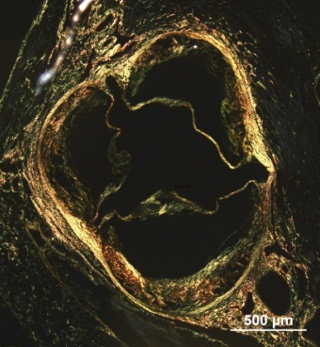
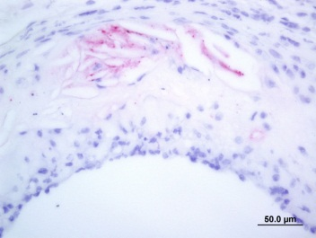
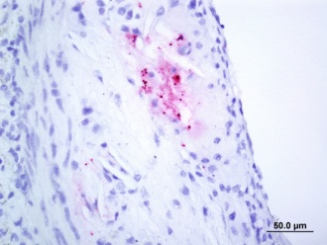
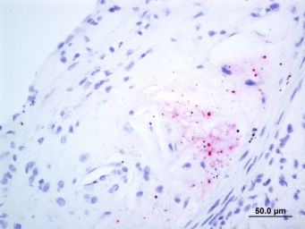
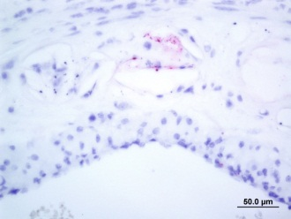
Collagen (Sirius Red Staining) and Apoptosis
in Sinotubular Junction: the 2nd ApoE Mouse Study
Control
Low dose (1.0 µCi)
Middle dose (1.7 µCi)
High dose (3.4 µCi)
Movat
Collagen (%)
60
50
40
30
20
p=0.29 (4 groups)
Sirius red
10
Control
Low
Middle
High
(1.0 µCi)
(1.7 µCi)
(3.4 µCi)
Apoptosis (%) (Apoptotic body/total cell count in hot spots)
Sirius red
(polarized)
35
p=0.81 (4 groups)
30
25
20
15
10
5
Control
Low
Middle
High
(1.0 µCi)
(1.7 µCi)
(3.4 µCi)
Sirius red and apoptosis staining were performed in selected mice. (n=24; 6 from each group)
Apoptosis

Slide 15
PRE-CLINICAL AND CLINICAL STUDIES
ANIMAL PRE-CLINICAL STUDIES COMPLETED AND HUMAN CLINICAL STUDIES - COMPLETED AND ONGOING
ANIMAL Pre-clinical Studies
Normal mouse and rabbit BD and atherosclerotic rabbit BD, therapy and imaging studies
CAROTID #1 (Very Low Dose Study)
Imaging and pathology on 6 CEA patients
500 µCi cGMP dose to determine dosimetry for Carotid #2 study
Pig and rabbit stent therapy studies
Normal mouse sterile abscess pK studies
Preliminary and validating Apo-E mouse therapy studies
CAROTID #2 (Low Dose Study)
Imaging and pathology on 5 CEA patients
Rat toxicity studies
Identification by U/S and histology of VP
Binding to VP
3 mCi cGMP dose
Identification by U/S and histology of VP
Binding to VP
Binding and imaging of AAA
Resuming imaging studies with the addition of therapeutic markers on 5 CEA patients

Slide 16
CAROTID #1 HUMAN CLINICAL STUDY (Very Low Dose Study)
Identified VP and Bound to VP
Neck Anterior
Neck Posterior
Phase 1 safety study to complete human dosimetry at a low dose (500 µCi) with no adverse effects
Confirmation that product bound human plaque

Slide 17
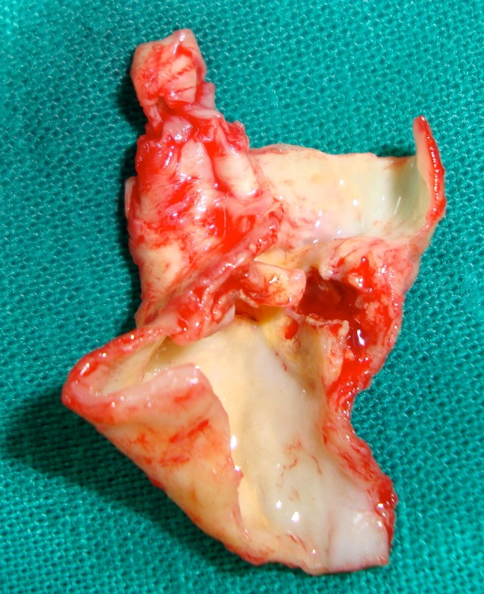
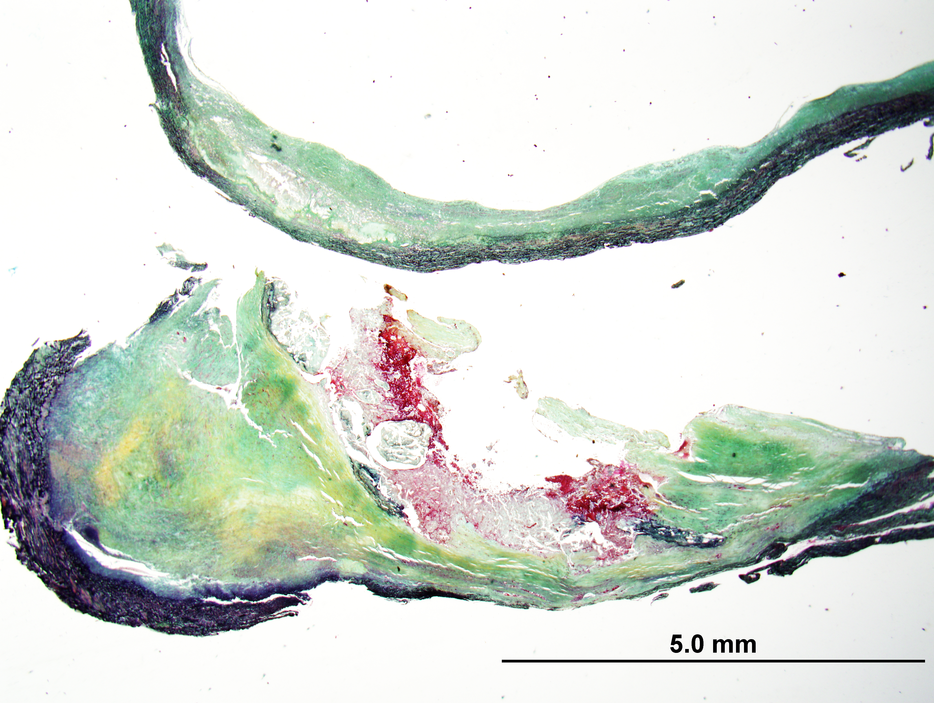
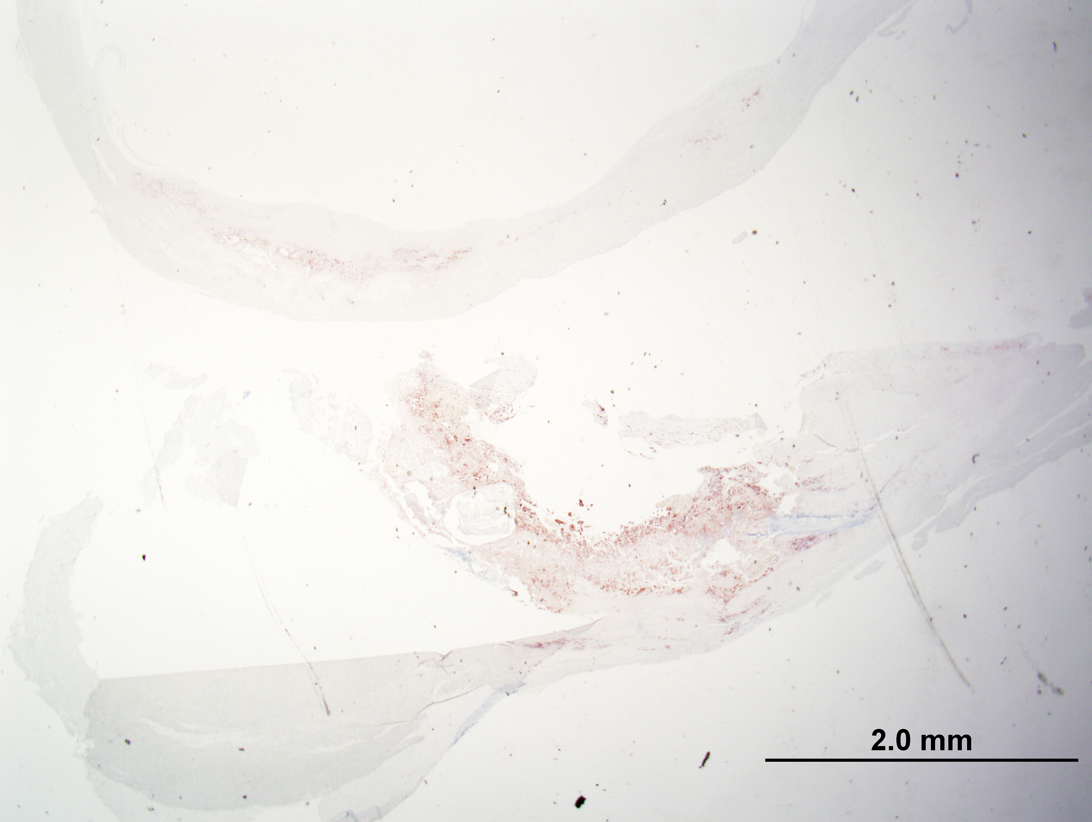
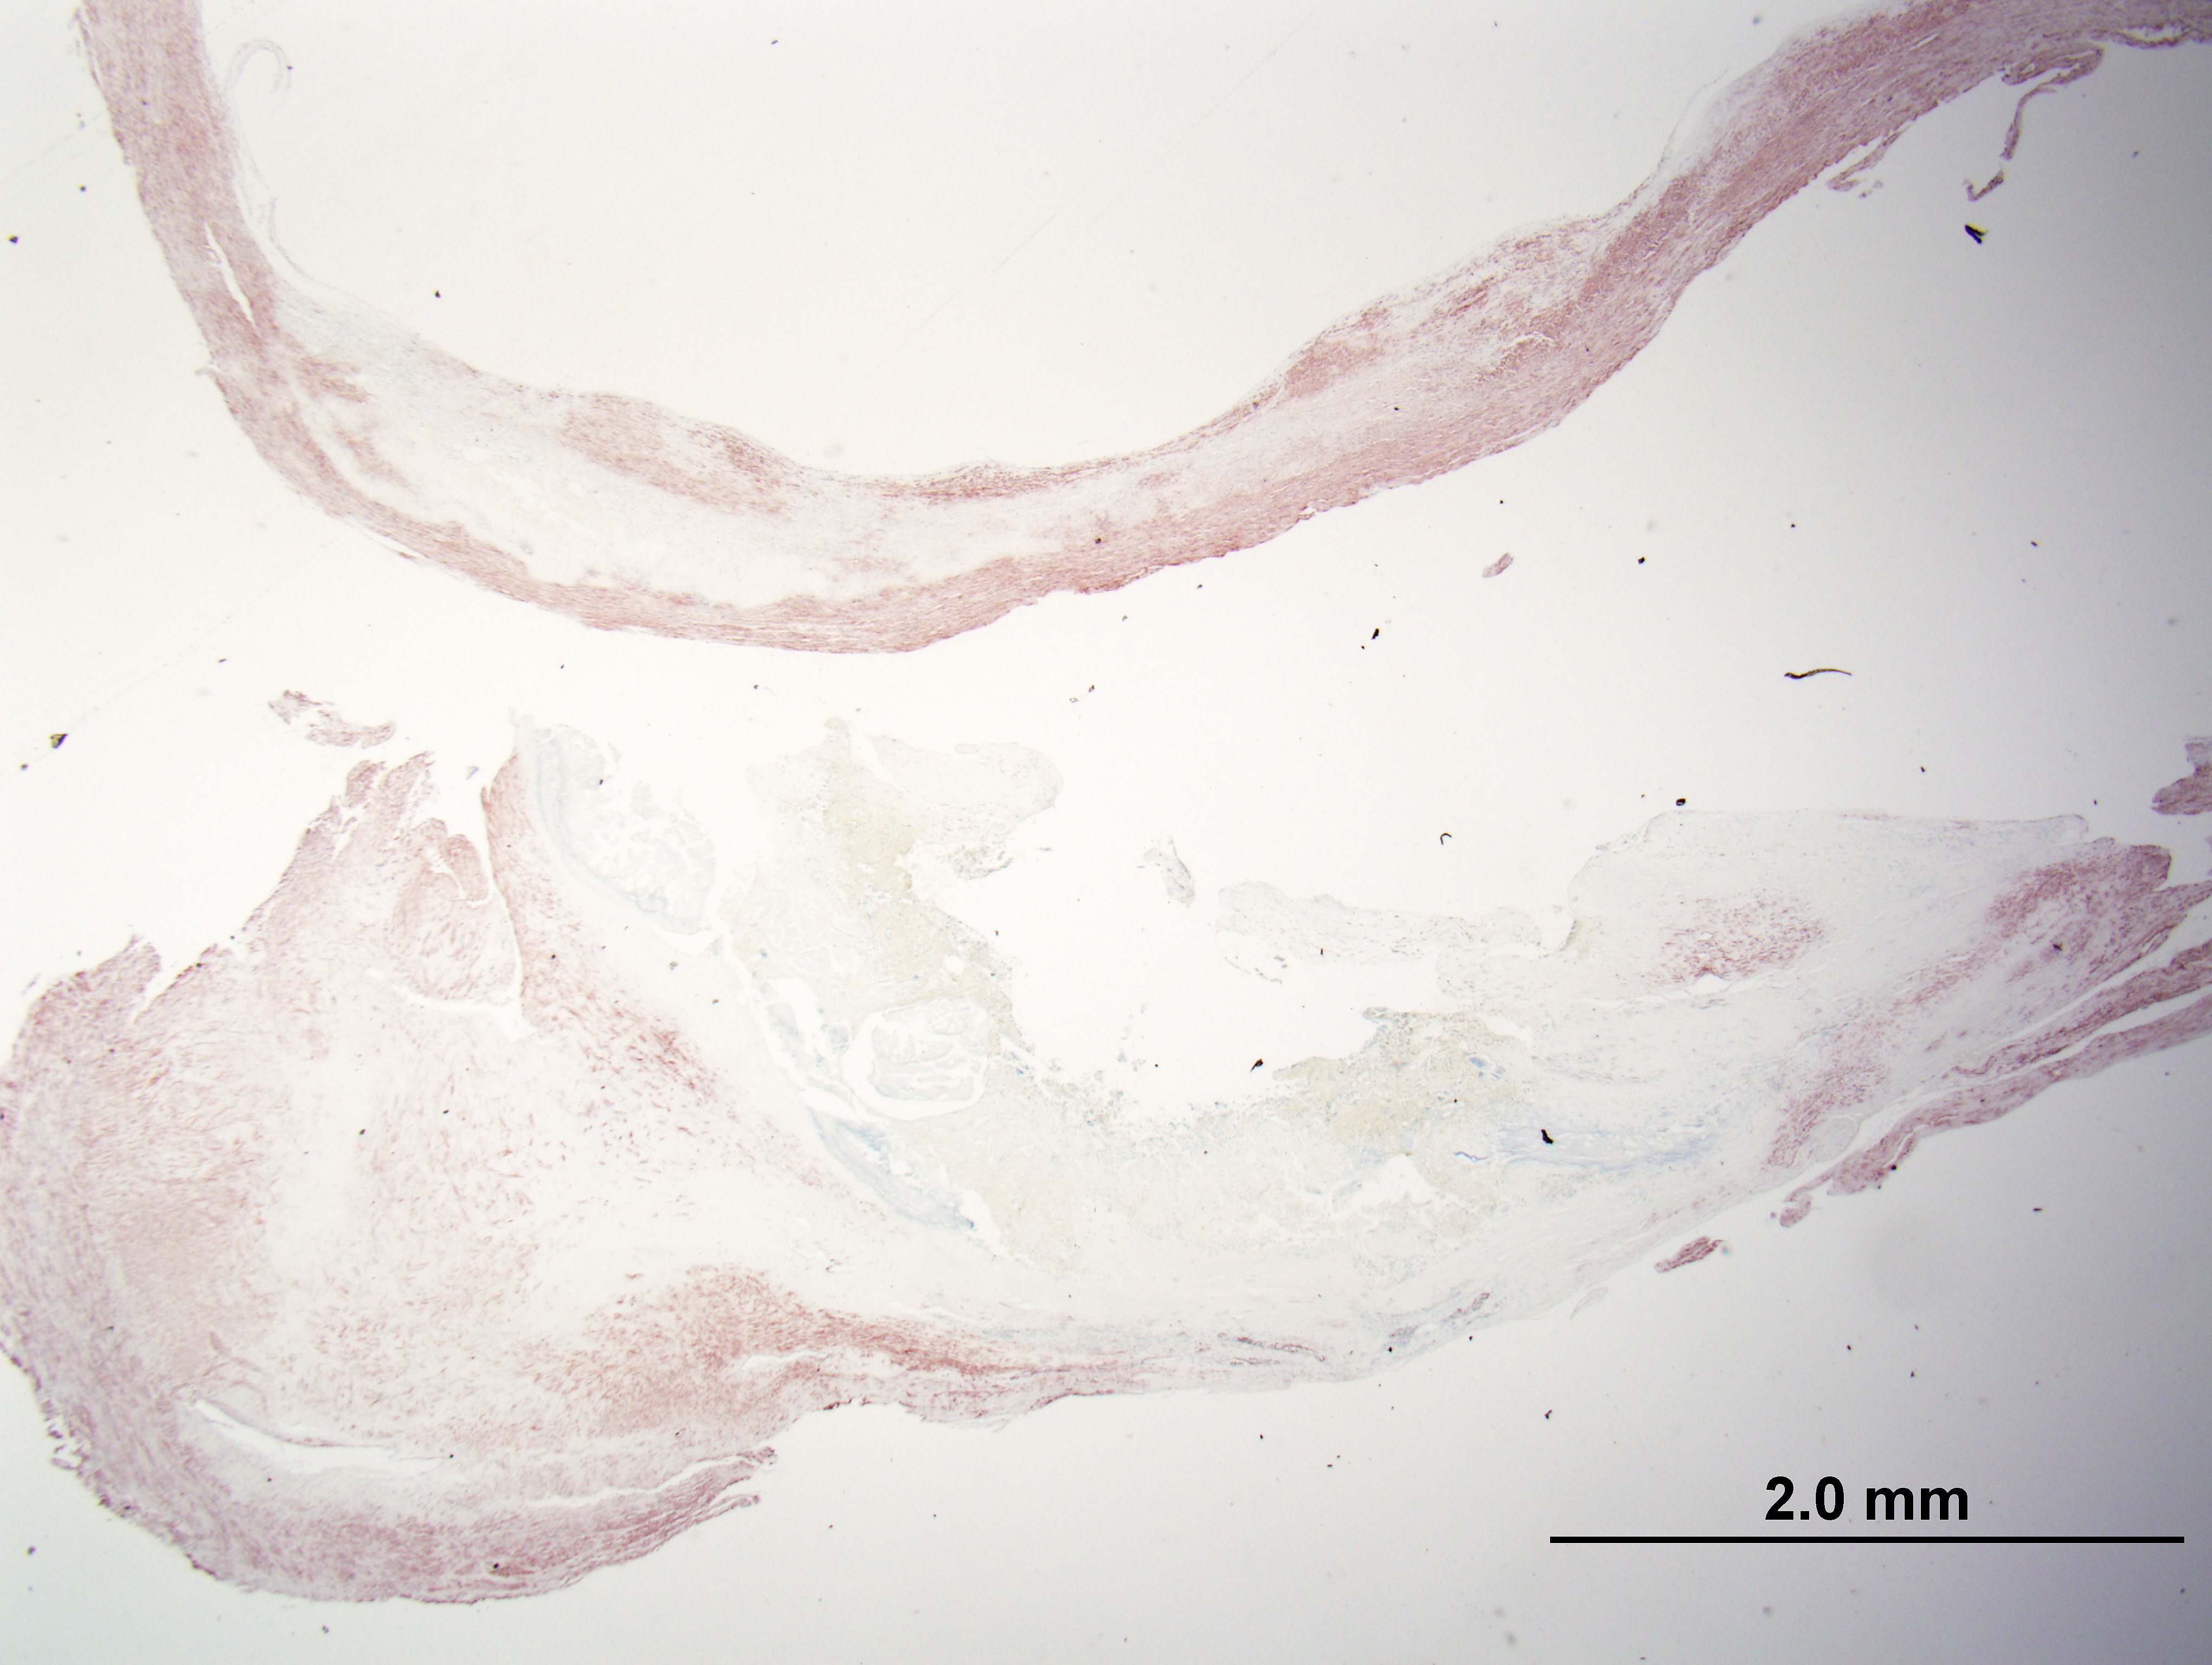
CAROTID #1 HUMAN CLINICAL STUDY (Very Low Dose Study)
Histology has shown that patients had vulnerable/ruptured plaques
The tagged annexin specifically identified in the region of the VP
NC
MAC
Tissue tagged with enough activity to count, but not to image.
SMC

Slide 18
PRE-CLINICAL AND CLINICAL STUDIES
ANIMAL PRE-CLINICAL STUDIES COMPLETED AND HUMAN CLINICAL STUDIES - COMPLETED AND ONGOING
ANIMAL Pre-clinical Studies
Normal mouse and rabbit BD and atherosclerotic rabbit BD, therapy and imaging studies
CAROTID #1 (Very Low Dose Study)
Imaging and pathology on 6 CEA patients
500 µCi cGMP dose to determine dosimetry for Carotid #2 study
Pig and rabbit stent therapy studies
Normal mouse sterile abscess pK studies
Preliminary and validating Apo-E mouse therapy studies
CAROTID #2 (Low Dose Study)
Imaging and pathology on 5 CEA patients
Rat toxicity studies
Identification by U/S and histology of VP
Binding to VP
3 mCi cGMP dose
Identification by U/S and histology of VP
Binding to VP
Binding and imaging of AAA
Resuming imaging studies with the addition of therapeutic markers on 5 CEA patients

Slide 19
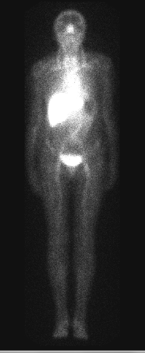
CAROTID #2 HUMAN CLINICAL STUDY (Low Dose Study)
Three of first 5 subjects showed tagging of carotid plaque, but not enough to image.
Subject 5
1 Hr. Anterior
24 Hr. Anterior
24 Hr. Whole Body

Slide 20
CAROTID #2 HUMAN CLINICAL STUDY (Low Dose Study)
“THE DARKER AREA IN THE ANEURYSM IS THE LUMEN, THE HAZE AROUND IT IS THE INFLAMMATION INDUCED BY CLOT IN THE ANEURYSM.” – H. WILLIAM STRAUSS, MD
Imaged an aortic aneurysm

Slide 21
CAROTID #2 HUMAN CLINICAL STUDY (Low Dose Study)
Two of 5 patients had vulnerable/ruptured plaque confirmed on histology containing excessive macrophages, lipid, and apoptotic bodies in the region of the necrotic core.
Subject 5
NC
NC
NC
(with hemorrhage)
Thin-fibrous cap
Movat
H/E
CD68 (macrophages)
Clear Vascular, Inc.
NC
NC
H/E
Oil Red O (Lipid)
Apoptosis

Slide 22
Summary
Simultaneous Localization and Treatment of Vulnerable Plaque by Tin-117m Conversion Electrons
Tin-117m can be detected by existing gamma cameras / SPECT imaging and its therapeutic conversion electron has strong ionization effect over relevant biological range, while annexin V binds to specific cell membrane chemicals that are expressed in apoptotic macrophages.
Injection of Tin-117 labeled annexin is associated with reduced expression of macrophages and greater expression of smooth muscle cells with greater collagen content and less apoptotic bodies in brachiocephalic arteries and sinotubular junction in a murine model of atherosclerosis.
The first human carotid study with a very low dose (500 µCi) injection showed the tagged annexin in carotid arteries where histology confirmed the presence of vulnerable/ruptured plaques. No adverse effects were observed.
The second human carotid study with a low dose (3 mCi) injection showed tagging of carotid plaques in 3 of 5 subjects where histology demonstrated the presence of vulnerable plaques in 2 subjects. Abdominal aortic aneurysm was also imaged by SPECT.
A systemic injection of Tin-117m-DOTA-Annexin has a potential therapeutic effect in stabilizing vulnerable atherosclerotic plaques that can be measured by imaging modalities. The therapeutic utility of this agent should be confirmed by further human clinical studies.

Slide 23
Acknowledgments
Funding
Clear Vascular, Inc.
CVPath Institute, Inc.
Gaithersburg, MD
CVPath Institute, Inc.
Frank D. Kolodgie, PhD
Fumiyuki Otsuka, MD, PhD
XiaoQing Zhao, PhD
Masataka Nakano, MD
Kenichi Sakakura, MD, PhD
Elena Ladich, MD
Lila Adams, HT
Washington DC

