Slide 1
A Comparison of Tissue Doses from Colloidal Sn-117m, P-32, Y-90, Re-186 and Er-169 for Radiosynoviorthesis Using Monte Carlo Simulation
Richard E. Wendt III UT MD Anderson Cancer Center, Houston TX and Nigel R. Stevenson Serene, LLC, The Woodlands TX

Slide 2
Acknowledgment and Disclosure
The work of REW was supported by an unrestricted grant from Serene, LLC.
NRS is an officer and owner in Serene, LLC.

Slide 3
Radiosynoviorthesis Radionuclides
Radionuclide | Application | e⁻ | Electron Range in ICRU 4-Component Tissue* (avg.; max. mm) | Half-life (days)
Y-90 (citrate) | Large (knee) | β | (4.05; 11.4) | 2.67
P-32 (Cr0₄P) | Large (knee) | β | (2.78; 8.3) | 14.3
Re-186 (sulfide) | Medium (elbow) | β | (1.06; 4.79) | 3.72
Er-169 (citrate) | Small (fingers and toes) | β | (0.14 [0.3†]; 1.07) | 9.40
Sn-117m (6 μm colloid) | Canine elbow (investigational) | CE | (0.241; 0.290 ) | 14.0
*NIST ESTAR database for electron CSDA ranges: http://physics.nist.gov/PhysRefData/Star/Text/ESTAR.html †Numerous sources state that the average range of Er-169 in tissue is 0.3 mm
Notes:
In this study, we have considered five radionuclides for radiosynoviorthesis. Four of them, Y-90, P-32, Re-186 and Er-169 are used clinically to treat the range of human synovial joints. Sn-117m in a colloidal preparation is being developed as an alternative to the first four. Conventionally, the range of the emitted beta or conversion electrons has been used to define the appropriate radionuclide for a particular size of joint. However, the physical half-life of the radionuclide might also be an important consideration in determining the better applications of a particular radionuclide.

Slide 4
Premise and Hypothesis
Conventional Premise: One should choose a radionuclide that has an electron range in tissue that is commensurate with the size of the joint synovium.
Hypothesis: Migration by macrophages containing longer-lived, short-range radioactive particles into all of the layers of the synovial tissues delivers therapeutic absorbed doses throughout the synovium.
Notes:
In particular, we are studying the hypothesis that a radionuclide with a relatively long half-life and shorter range emissions can effectively treat larger joints, provided that it is taken up by the macrophages and transported into the deeper portions of the synovial tissue.

Slide 5
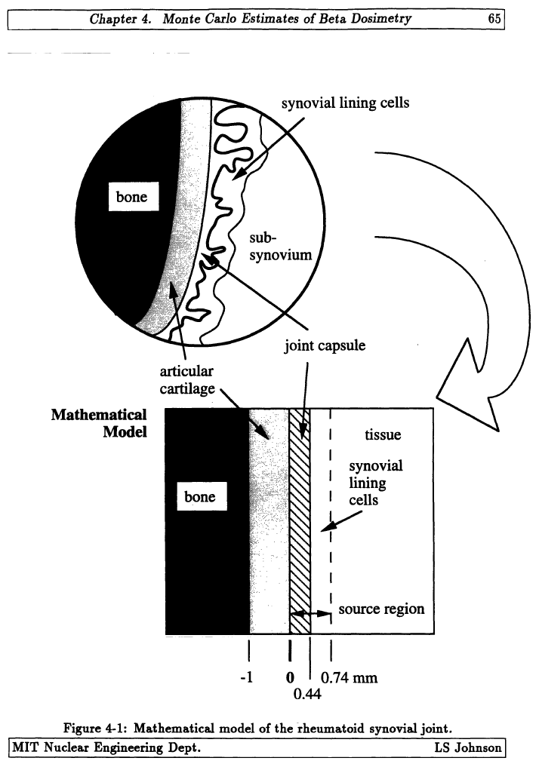
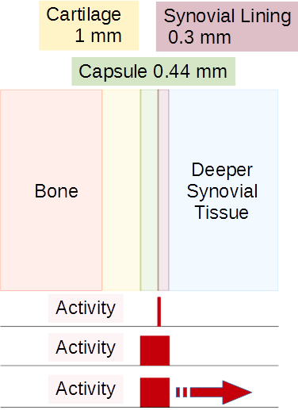
Model of the Synovial Joint
LS Johnson, Beta-Particle Dosimetry in Radiation Synovectomy and Use of the ¹⁰B(n,α) Nuclear Reaction to Examine the Pathology of Rheumatoid Arthritis, PhD, Massachusetts Institute of Technology, 1994, p. 65. Figure used with the permission of Dr. Johnson.
Notes:
The model of the synovial joint that we used was developed by Scott Johnson in the early 1990’s. It is for a mildly arthritic joint in which the synovial lining is about 300 microns thick. On the small scale of the range of beta particles, the rippling nature of the synovial membrane is approximated by parallel planes. The layers consist of bone, a millimeter of cartilage, 440 microns of capsular space containing the synovial fluid, 300 microns of synovial lining and then deeper synovial tissue. In Johnson’s work, the radioactivity was assumed to be distributed uniformly within the capsule and the cells of the synovial lining. We have investigated three distributions of the five radionuclides: stationary activity at the interface between the capsule and the lining, stationary activity uniformly distributed within the capsule and the lining, and activity that starts out in the capsule and the lining and migrates deeper and deeper into the synovial tissue over time.

Slide 6
Monte Carlo Simulation
GATE 8.0 Monte Carlo simulations
The source definitions were built using the complete radionuclide emissions data from ICRP 107.
Johnson’s model was built as a stack of 4 cm-diameter disks of the specified thicknesses for each layer.
The spatial resolution perpendicular to the synovial tissue was 0.1 mm.
The GATE materials were “Rib Bone” for the bone, “Cartilage” for the cartilage, “Water” for the capsule and “Muscle” for the synovium.
The QBBC_EMY physics list was used.
Two million events were simulated for each scenario.
Notes:
We used the GATE Monte Carlo software in order to perform these simulations. The source files for each radionuclide contain every emission in the ICRP 107 data base. We implemented Johnson’s model as a stack of 4 cm-diameter disks with the specified thicknesses. The spatial resolution of the dose actor was 0.1 mm perpendicular to the layers of the model. We used standard GATE material definitions and the QBBC_EMY physics list. Two million events were simulated for each scenario.

Slide 7
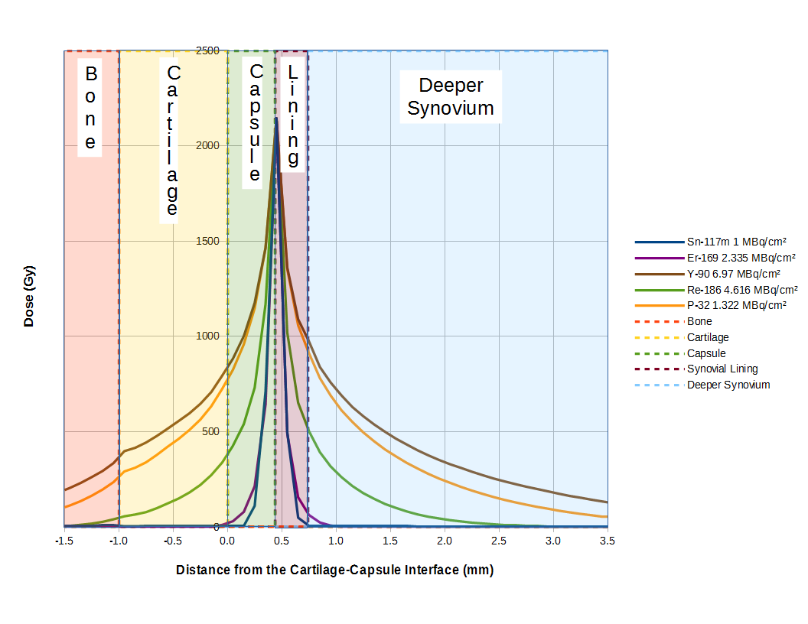
Stationary Activity on the Surface of the Synovial Lining
Notes:
When all of the activity is stationary at the plane separating the capsule from the lining, the spatial distributions of radiation absorbed dose of the various radionuclides are similar to their beta dose kernels. They have spatial extents that correspond to their average and maximum electron ranges since the dose is largely imparted by the non-penetrating emissions. In this plot, the activity of each radionuclide was chosen to deliver the same dose as 1 MBq/cm² of Sn-117m.

Slide 8
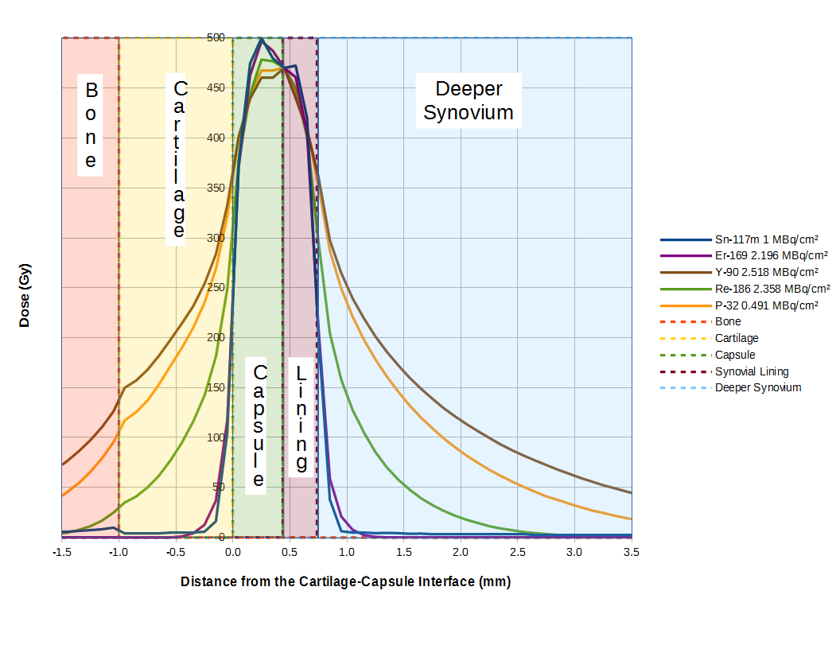
Stationary Activity in Capsule and Lining
Notes:
When the stationary activity is uniformly distributed within the capsule and the synovial lining, there is a similar relative spatial distribution of radiation absorbed dose. Note that the lower energy radionuclides, Er-169 and Sn-117m, treat very little of the deeper synovial tissue in this scenario.

Slide 9
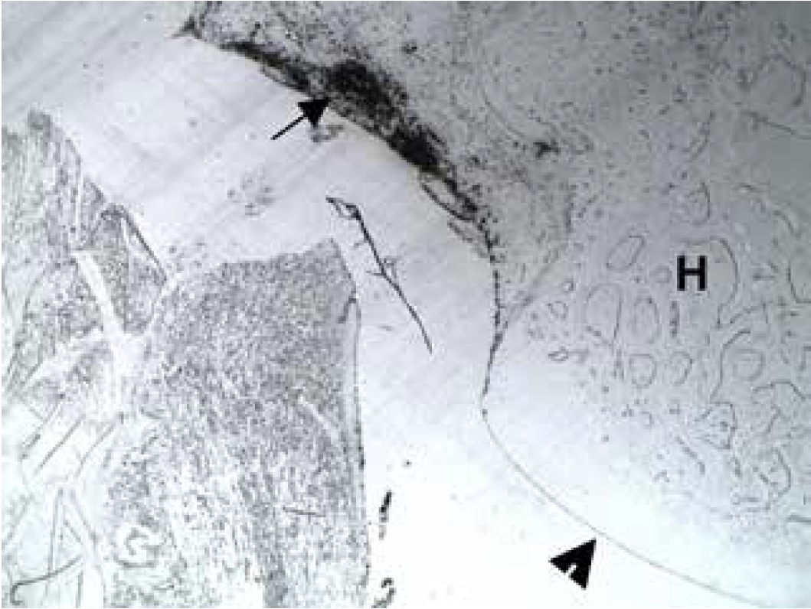
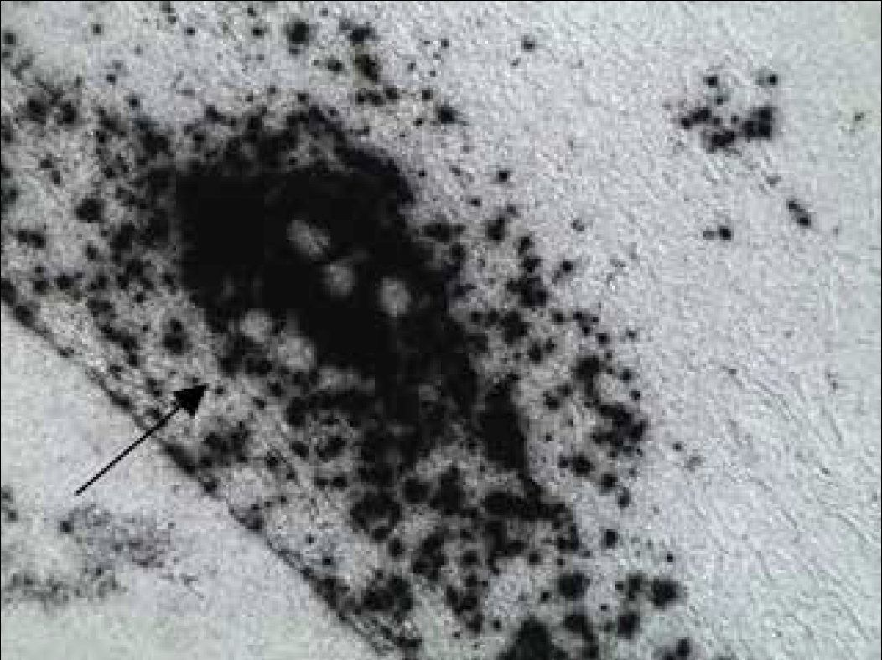
Macrophage Action
Radioactive colloidal particles are collected on the synovial lining and then transported deeper into the synovial tissue.
100×
400×
The arrow (→) indicates an area of inflammation in the autoradiographs.
Notes:
However, there is evidence that suitably sized radioactive colloidal particles are eventually transported deeper into the synovial tissue. These autoradiographs were made seven weeks after treatment with a Sn-117m colloid.

Slide 10
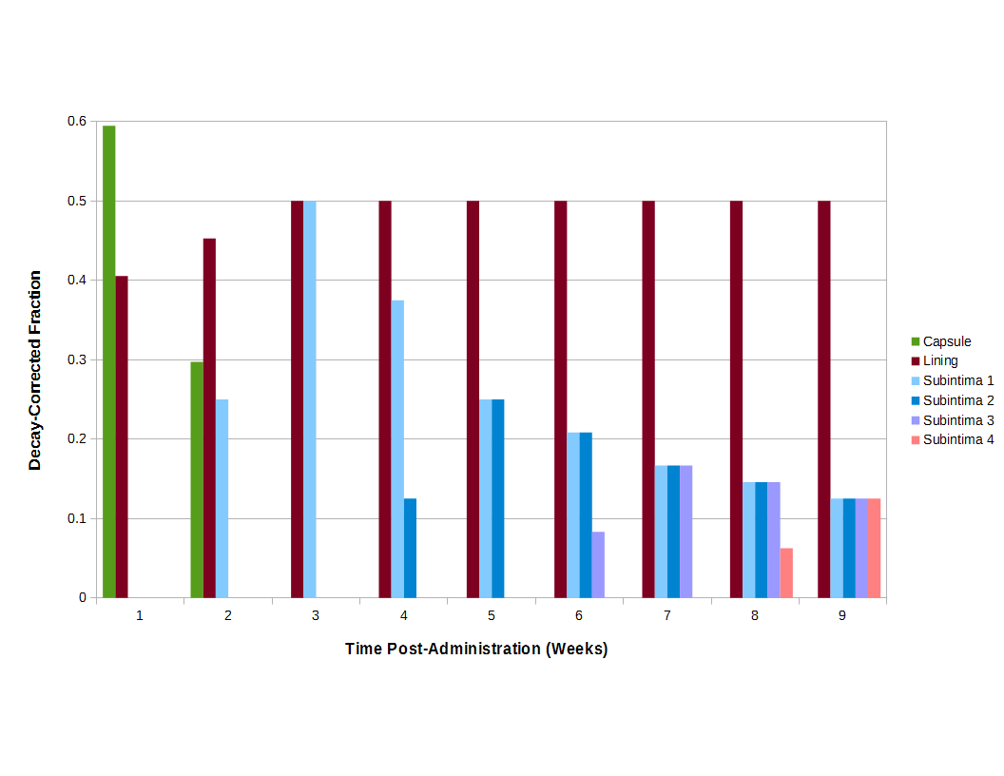
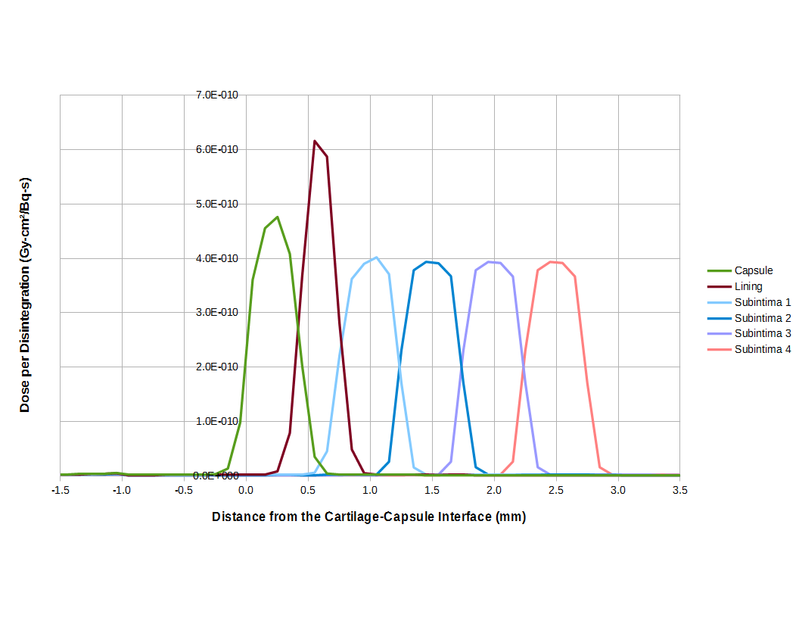
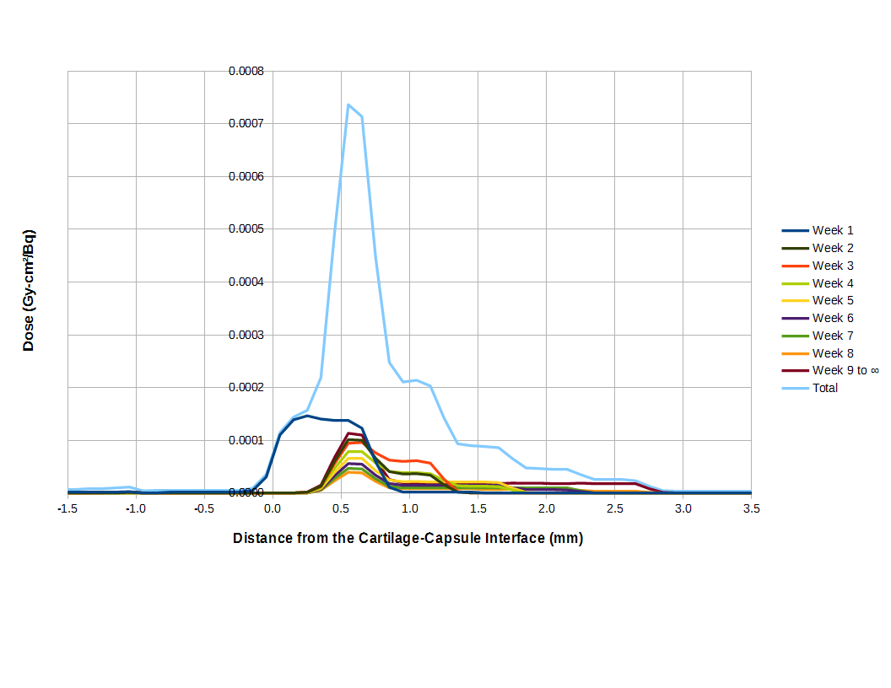
Model of Moving Radioactivity
×
=
Notes:
We modeled this transportation and the resulting dose distribution in a discrete fashion. We assumed that the activity in the capsule would disappear within two weeks while the activity in the lining would increase slightly until the third week, after which it would remain steady. We assumed that the activity in the deeper layers of the synovial tissue would demonstrate delayed uptake curves that would level out to a uniform distribution by the end of the ninth week. We simulated the spatial distributions of dose per disintegration from each of the radionuclides uniformly distributed in each of six layers: the capsule, the lining, and four subintimal layers. These doses were then multiplied by the relative activity at their locations and the cumulated activity at those locations and times to produce a total dose distribution once the activity had completely decayed.

Slide 11
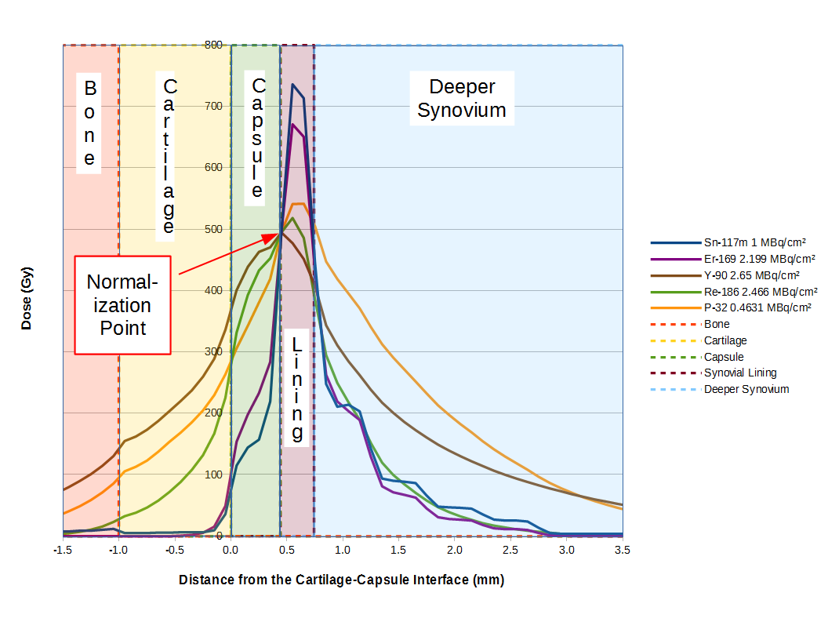
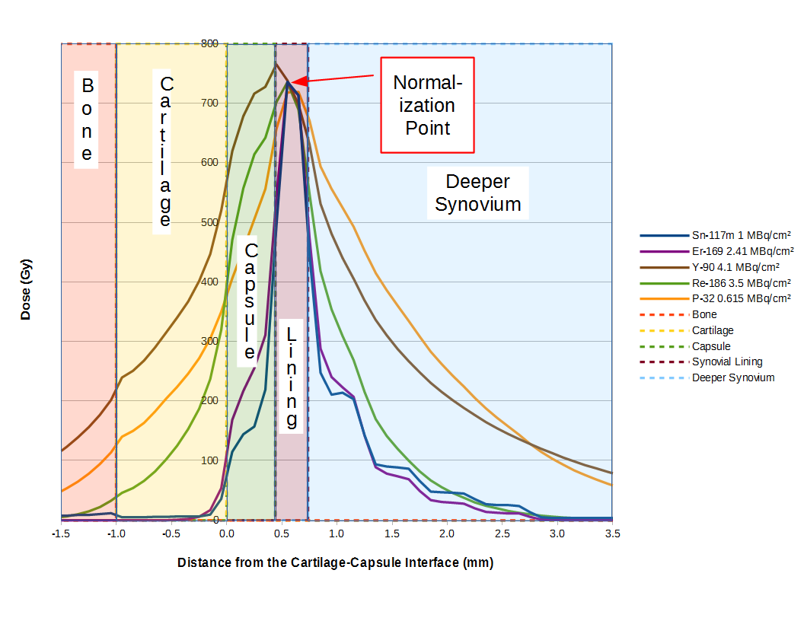
Moving Source Dose Distributions
Nuclide | Rel. Act.
Sn-117m | 1.00
Er-169 | 2.20
Y-90 | 2.65
Re-186 | 2.47
P-32 | 0.463
Nuclide | Rel. Act.
Sn-117m | 1.00
Er-169 | 2.41
Y-90 | 4.10
Re-186 | 3.50
P-32 | 0.615
Notes:
The results of simulating moving distributions of the five radionuclides is shown with two normalizations. One is to deliver the same dose to the interface between the capsule and the lining and the other is to deliver the same dose to the center of the lining. In particular, note that the dose that is delivered to the deeper layers of the synovial tissue is very similar for Re-186, Er-169 and Sn-117m. At the same time, Er-169 and Sn-117m spare deliver a substantially lower dose to the cartilage and bone than do the other radionuclides.

Slide 12
Discussion and Conclusion
The relatively long half-lives of P-32, Er-169 and Sn-117m potentially allow them to be carried well into the synovial tissue before depositing all of their energy, assuming a suitable particle size.
With the movement model in this study, the dose distributions of Er-169, Re-186 and Sn-117m are very similar.
The further investigation of Sn-117m for the radiosynoviorthesis of medium-sized as well as smaller-sized joints is warranted.
Notes:
It is thus important to design a colloid that the macrophages will transport deeply into the synovial tissue. With such a colloid, Er-169, Re-186 and Sn-117m appear to deliver similar doses to the synovial tissue. We thus conclude that Sn-117m should be investigated for use in medium- as well as smaller-sized joints.

